Slide 1
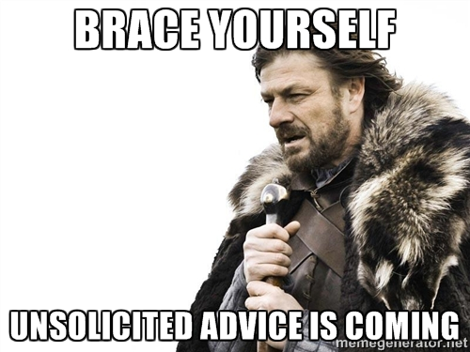

Slide 2
Design Principles
Since no one knows how to build a system without flaws, the alternative is to rely on eight design principles, which tend to reduce both the number and the seriousness of any flaws:
economy of mechanism
fail-safe defaults
complete mediation
open design
separation of privilege
least privilege
least common mechanism
psychological acceptability
The Protection of Information in Computer Systems. JEROME H. SALTZER AND MICHAEL D. SCHROEDER

Slide 3
Guiding Principles for Software Security
Secure the Weakest Link
Practice Defense in Depth
Fail Securely
Follow the Principle of Least Privilege
Compartmentalize
Keep It Simple
Promote Privacy
Remember That Hiding Secrets Is Hard
Be Reluctant to Trust
Use Your Community Resources
Building Secure Software: How to Avoid Security Problems the Right Way. John Viega and Gary McGraw

Slide 4
The Six Dumbest Ideas in Computer Security
#1) Default Permit
#2) Enumerating Badness
#3) Penetrate and Patch
#4) Hacking is Cool
#5) Educating Users
#6) Action is Better Than Inaction
http://www.ranum.com/security/computer_security/editorials/dumb/

Slide 5
Engineering Security Maxims
Infinity Maxim: There are an unlimited number of security vulnerabilities for a given security device, system, or program, most of which will never be discovered.
Arrogance Maxim: The ease of defeating a security device or system is proportional to how confident/arrogant the designer, manufacturer, or user is about it, and to how often they use words like “impossible” or “tamper-proof”.
Plug into the Formula Maxim: Engineers don’t understand security. They think nature is the adversary, not people. They tend to work in solution space, not problem space. They think systems fail stochastically, not through deliberate, intelligent, malicious intent.
Rohrbach’s Maxim: No security device, system, or program will ever be used properly (the way it was designed) all the time.
We’ll Worry About it Later Maxim: Effective security is difficult enough when you design it in from first principles. It almost never works to retrofit it in, or to slap security on at the last minute.

Slide 6
Know your enemy

Slide 7


Anyone can invent a security system that he himself cannot break. …When someone hands you a security system and says, "I believe this is secure," the first thing you have to ask is, "Who the hell are you?" Show me what you've broken to demonstrate that your assertion of the system's security means something.
Therefore I say: Know your enemy and know yourself; in a hundred battles you will never be in peril

Slide 8
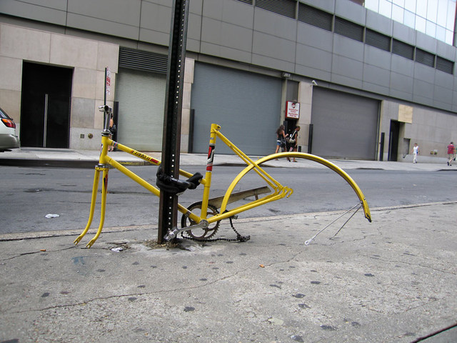


"Locks keep out only the honest."

Slide 9


Slide 10
Weakest Link

Slide 11

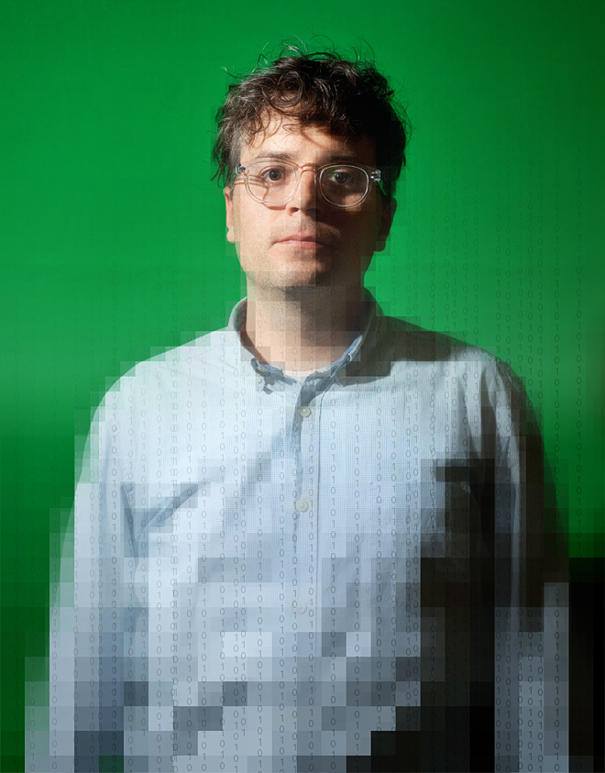
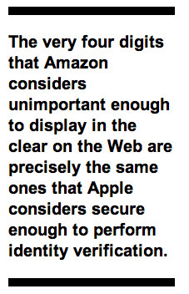

Slide 12
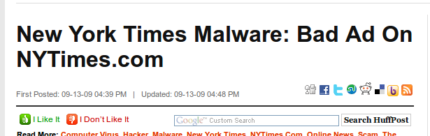
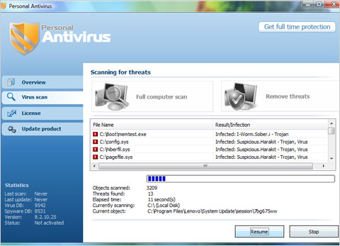
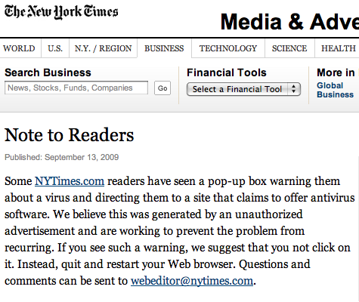

Slide 13
Least Privilege

Slide 14


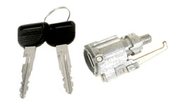

Slide 15
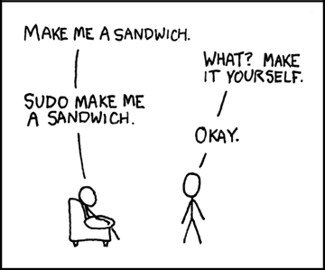

Slide 16
Security by obscurity

Slide 17
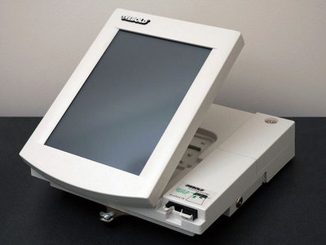

Slide 18
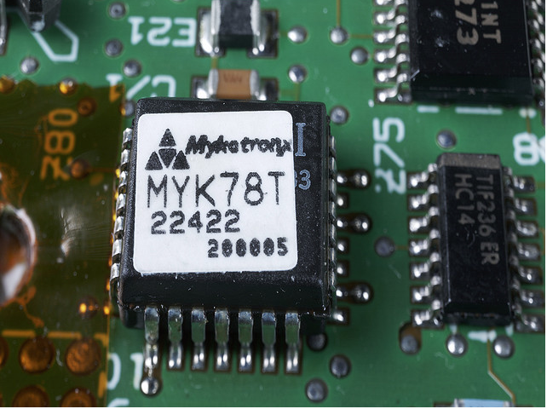

Slide 19
Keep it Simple Stupid

Slide 20
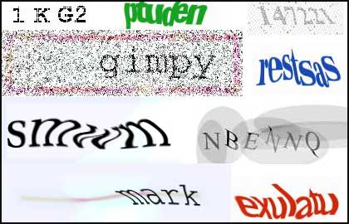
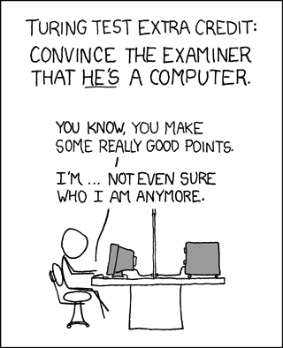

Slide 21
Deny By Default

Slide 22


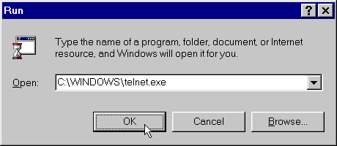

Slide 23
Fail Safe

Slide 24
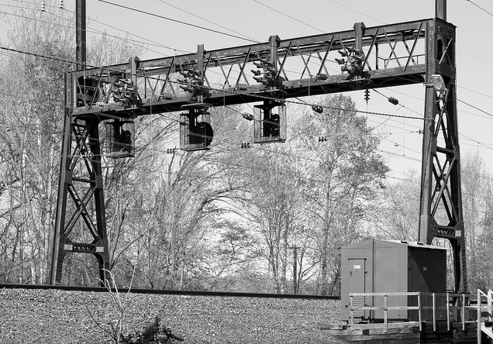
Most signaling schemes have the property that a single component or communications failure is guaranteed to cause the signal to appear at least as restrictive as it would without the fault. But the phase break indicator is at its most restrictive when fully illuminated, a violation of fail-safe design principles.

Slide 25



Slide 26
Don’t Do It Yourself

Slide 27

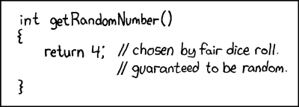

Slide 28
Question Assumptions

Slide 29
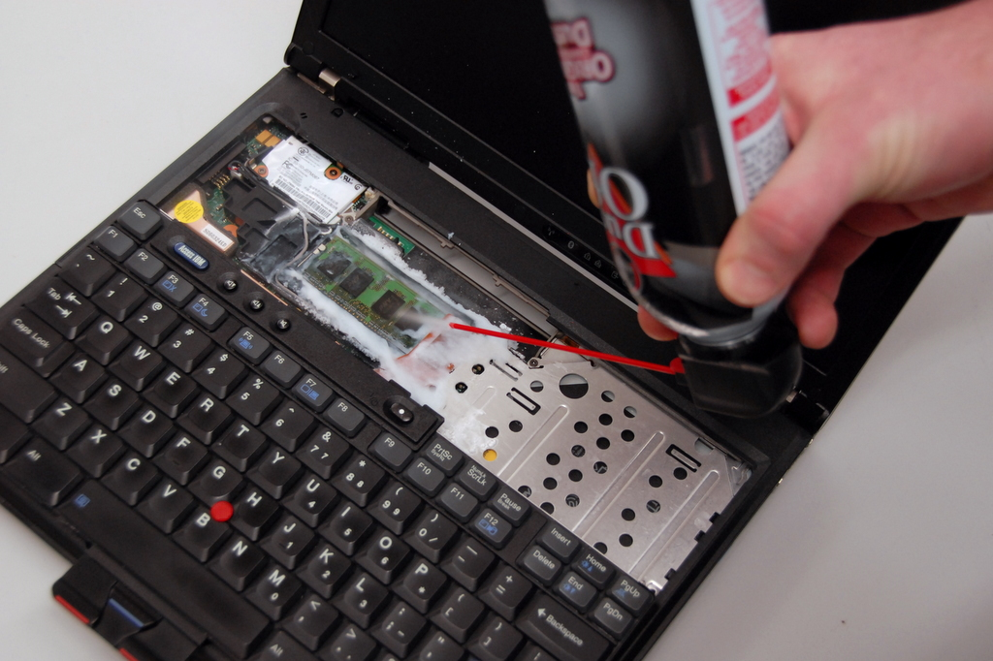

Slide 30
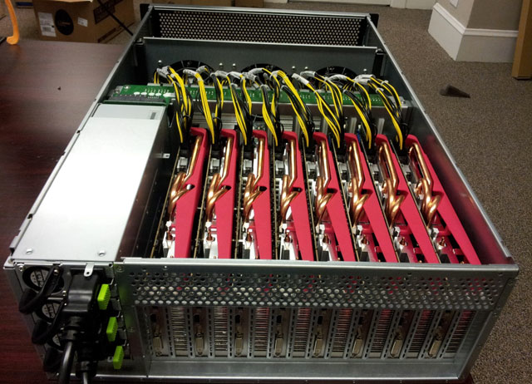

Slide 31
Usability

Slide 32
